Slide 1
DA 204
Artificial Intelligence
Protecting Privacy in the Presence of Data Dependencies
Abhi
22125002

Slide 2
Differential Privacy
Differential privacy (DP) is a widely accepted mathematical framework for protecting data privacy. Simply stated, it guarantees that the distribution of query results changes only slightly due to the modification of any one tuple in the database. This allows protection, even against powerful adversaries, who know the entire database except one tuple.
For providing this guarantee, differential privacy mechanisms assume independence of tuples in the database – A vulnerable assumption.
Directly taken from paper

Slide 3
Vulnerabilities and Challenges
Identification of vulnerabilities in traditional DP due to data dependencies.
Challenges in achieving privacy guarantees in the presence of natural dependencies.
Previous efforts to address data dependencies using Pufferfish and Blowfish frameworks.

Slide 4
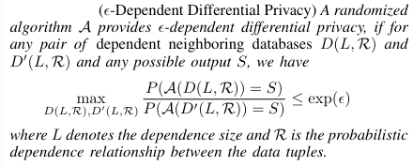
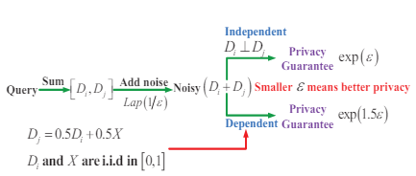
Dependent Differential Privacy (DDP)

Slide 5
Mechanism Design for DDP
Baseline approach for achieving ε-dependent differential privacy and its limitations.
Introduction of the Dependent Perturbation Mechanism (DPM) and its role in minimizing noise while ensuring ε-DDP guarantees.
Theoretical foundations and practical implications of the DPM.

Slide 6



Addressing Dependence Coefficient
where ∆Di, ∆Dj is the maximal difference due to the change in Di,Dj resp.
Scaling factor of the Laplace noise as σ(ε) = ∆Di / ε ,
ρij = extent of dependence induced in Dj by the modification of Di.
Self Indistinguishability represents the maximal difference of Dj caused by the modification of Dj itself.
Dependent Indistinguishability evaluates the maximal expected difference in Dj caused by the modification of Di.

Slide 7
Implications of Dependence Coefficient in System Design
Complete Knowledge of Dependence Relationship.
Knowledge About Data Generation.
Challenges in Realistic Scenario :
A) Overestimation of ρij
B) Underestimation of ρij :
a) More than Adversary’s expectation
b) Less than Adversary’s expectation

Slide 8
Summary of Experimental Analysis
• DPM provides significant privacy and utility gains compared to the state-of-the-art approaches. Therefore, we can select a suitable privacy budget to achieve an optimal privacy and utility balance for DPM.
• DPM is more than 2x accurate in computing the K-means clustering centroids and the SVM classifier, and more than 10x accurate in publishing degree distribution of large-scale social network, compared with existing approaches (which may not even provide rigorous privacy guarantees). These results demonstrate the effectiveness of DPM in real-world query answering for network data.
• DPM is resilient to adversarial inference attack and provides rigorous privacy guarantees for dependent tuples that are not possible using LPM-based DP schemes.

Slide 9
References
https://www.princeton.edu/~pmittal/publications/ddp-ndss16.pdf
https://www.youtube.com/playlist?list=PLmd_zeMNzSvRRNpoEWkVo6QY_6rR3SHjp

Slide 10
Thank You
Any Query ?

